Slide 1
Designing for Security
Apply General Principles for Secure Design
Design Software to Counter Specific Threats

Slide 2
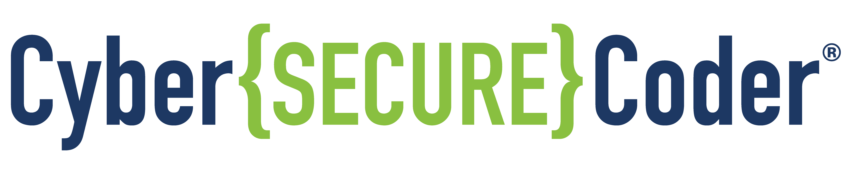
Apply General Principles for Secure Design

Slide 3
Security in the Design Phase
Architect and design
Identify requirements
Test
Deploy and maintain
Develop
Your focus on security should improve:
The software you produce.
The processes and tools you use to produce software.
Some organizations focus on security issues in testing or development, but neglect security in the design phase.
Design flaws:
Are responsible for an estimated 50% of security issues.
Are typically harder to detect during testing and more costly to correct than coding flaws.
Are less costly and less complicated to fix the earlier they are found.
Good development process is the key to secure app development.
Many aspects of security are inexpensive to implement, particularly if done early in a project.
As you promote secure app development in your organization, find ways to integrate it into the entire process.
It requires much more effort to remediate for bad security design at the end of the project than to build security into the design from the start.

Slide 4


Security by Obscurity vs. Security by Design
Security by Obscurity
Intention is to keep the system secure by keeping its security mechanisms confidential.
May slow down some attackers, but should never be your sole means of defense.
Drawbacks:
You must keep the system's design hidden from everyone, even your customers.
Attacker may still be able to reverse engineer the system to figure out how it works.
Using it as your only protection may give you a false sense of security.
May make it more difficult for developers to write, understand, and maintain code.
Security by Design
Assumes attacker has knowledge of the app's design.
Designs system to be secure even when its inner workings are known.
Strengths:
A more foundational approach to security than by obscurity.
Relies on the strength of the code itself, not just how well that code can be deciphered.

Slide 5

OWASP Security Design Principles
Ten principles for the design of secure software, based on two primary sources:
“The Protection of Information in Computer Systems”
1975 paper by Jerome H. Saltzer and Michael D. Schroeder
Writing Secure Code
2001 book by Howard and Le Blanc
The principles:
Minimize attack surface area.
Establish secure defaults.
Least privilege.
Defense in depth.
Fail securely.
Don't trust services.
Separation of duties.
Avoid security by obscurity.
Keep security simple.
Fix security issues correctly.
SECURITY DESIGN

Slide 6
Minimize Attack Surface Area
Reduce risk by reducing software features that can be attacked.
Every feature you add brings potential risks, increasing the attack surface.
You can improve security by:
Adding defenses around the features you add.
Not adding the features in the first place (better choice, if you have this option).
Avoid using components with known vulnerabilities.
Use updated versions of components when available.
Example:
A web application has a searchable Help feature that may be vulnerable to SQL injection.
Good option: Add protections to the Help feature, such as input validation.
Better option: Improve the Help system user interface so Search is not needed at all.
SECURITY DESIGN

Slide 7
Establish Secure Defaults
Settings for a freshly installed application should be set to the most secure option.
Leave it to the user to change settings that may decrease security.
Example:
By default, features that enforce password aging and complexity should be enabled.
You provide settings for user to disable these features to simplify their use of the software.
Warn users that they are increasing their own risk when changing default values.
X
User must change password after 90 days
X
Do not allow passwords shorter than 8 characters.
SECURITY DESIGN

Slide 8
Least Privilege
Users and processes should have only privileges needed to perform their work.
This principle applies to all sorts of access:
User rights
Resource permissions such as CPU limits, memory, network
File system permissions
Example:
To perform its work, a middleware server must be able to:
Access the network
Read a database table
Write to a log
Under no circumstances should the server have administrative privileges.
SECURITY DESIGN

Slide 9
Least Common Mechanism
Minimize how much a single mechanism is used to grant access to a resource.
The more a system depends on a single piece of software, the greater the risk.
Prefer to use different mechanisms for different classes of users/different instance for every single user.
SECURITY DESIGN

Slide 10
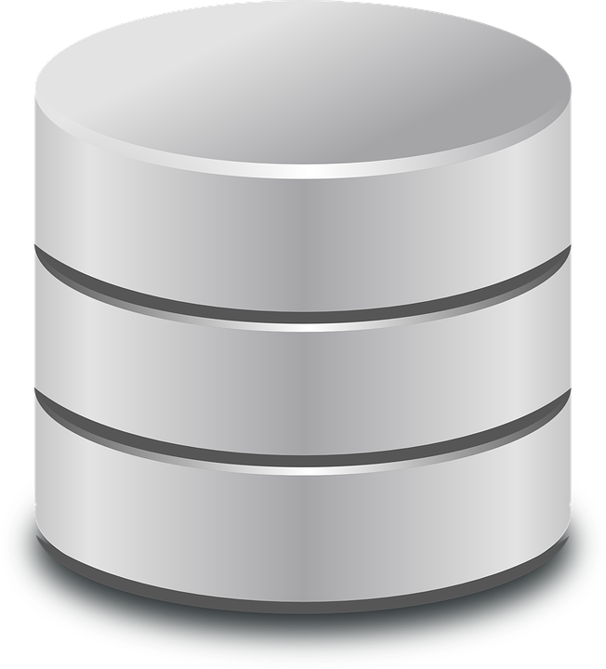
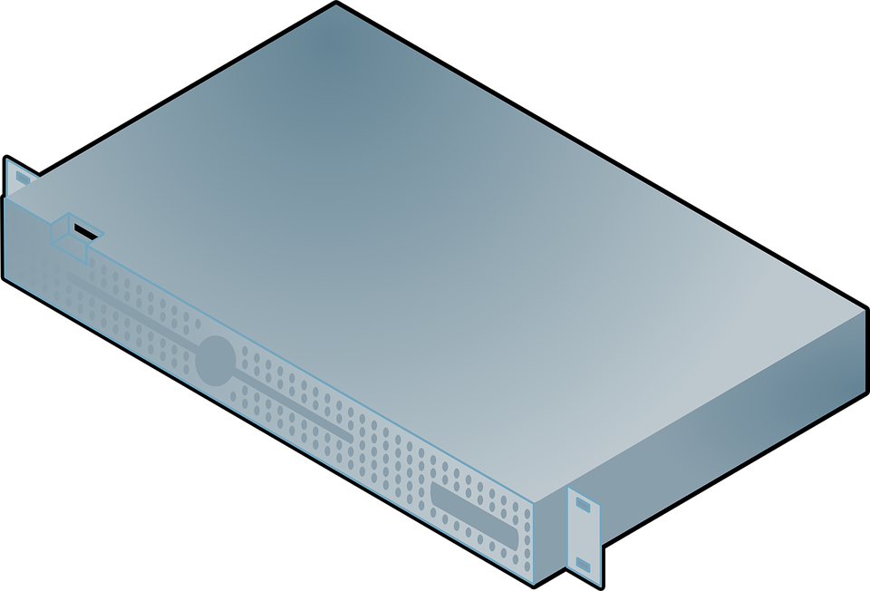



Defense in Depth
Each module should have its own security controls.
Multiple layers of modules will result in having multiple layers of defense.
Some modules may share controls, such as a centralized input validation module.
Example:
Each tier in a multi-tier application performs input validation and output sanitization.
A server is protected from unauthorized network traffic by a firewall.
Network traffic behind the firewall is encrypted to further protect data should an attacker penetrate the firewall.
Sanitize
output
Database
Server
Encrypted network
Validate input
Firewall
Validate input
Sanitize
output
Client
Application
Server
Validate input
Firewall
Encrypted network
Sanitize
output
SECURITY DESIGN

Slide 11
Fail Securely
When a function or transaction fails, you should leave the system in a secure state.
Examples:
If codeThatMayFail() fails, remaining statements within try block will not execute.
Example 1 (bad code) will end up with isAdmin set to true.
Example 2 (better code) will end up with isAdmin set to false.
An attacker could force an error in example 1 to get admin access.
// Example 1 (bad code)
isAdmin = true;
try {
codeThatMayFail();
isAdmin = isUserInRole( "Administrator" );
} catch (Exception ex) {
log.write(ex.toString());
}
// Example 2 (better code)
isAdmin = false;
try {
codeThatMayFail();
isAdmin = isUserInRole( "Administrator" );
} catch (Exception ex) {
log.write(ex.toString());
}
SECURITY DESIGN

Slide 12
Don't Trust Services
Third-party partners probably have security policies and posture different from yours.
You should verify all transactions with any external system.
When integrating with third-party services, use:
Authentication mechanisms
API monitoring
Failure and fallback scenarios
Modular code that you could quickly swap to a different third-party service, if necessary
Example:
A loyalty program provider provides data that:
Is used by Internet Banking (electronic payment system)
Identifies the number of reward points accumulated by the user
Provides a small list of potential redemption items the user is eligible for
However, the incoming data should be checked to ensure that:
The data is safe to display to end users (e.g., no injected code or unsafe characters)
The reward points are a positive number
The reward points are not improbably large
SECURITY DESIGN

Slide 13
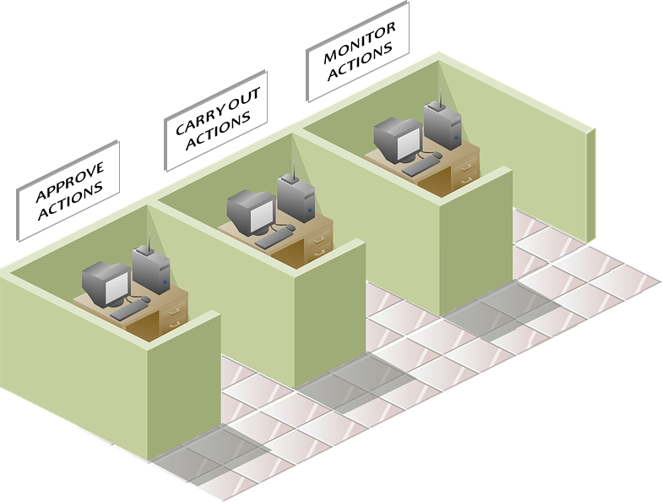
Separation of Duties
Implement checks and balances in roles and responsibilities to prevent fraud.
Reduces errors in development and testing.
A programmer might forget about fixes to their own environment that makes the app run
For example, an administrator role:
Should be able to do things like:
Turn the system on or off
Set password policy
Change system-wide settings
Should not be able to do things like:
Log in to a storefront as a super user and buy goods on behalf of other users
An application:
Should be developed in one environment
Should be tested in another environment by a different person
SECURITY DESIGN

Slide 14

Security by Obscurity
Weak approach
Should not be used as the only security control
Never design the application assuming that source code will remain secret, even if you plan to keep the source code secret
Rely on other protections such as:
Reasonable password policies
Defense in depth
Business transaction limits
Solid network architecture
Fraud and audit controls
SECURITY DESIGN

Slide 15
Keep Security Simple
Complex architecture increases the possibility of:
Errors in implementation, configuration, general use
Effort needed to test and maintain these aspects
Constantly be on the lookout for a simpler approach.
Avoid elaborate implementations to secure a particular feature by not providing that feature in the first place.
A
B
A
B
SECURITY DESIGN

Slide 16
Fix Security Issues Correctly
Once you identify a security issue:
Determine the root cause
Develop a test for it
When you use design patterns:
Security issue will likely be widespread across all code bases.
It is essential to develop the right fix without introducing regressions.
Example:
A bug enables one user to see another user's balance in a web application.
It's an easy fix.
You've used the defective code in several applications, so a change to just one application will trickle through to the other applications.
The fix must therefore be tested on all affected applications.
SECURITY DESIGN

Slide 17
Software Design Patterns
Software design patterns are:
Reusable solutions to common problems in software development.
Developed and improved over time by a community of developers.
Help to save time and reduce mistakes during the design phase.
Often incorporated into development frameworks, which can save time and reduce mistakes in the implementation phase.
May be expressed as written documents that describe:
The problem the pattern addresses
The context it applies to
The solution itself
The structure of the pattern
Other notes, variants, examples, benefits, and possible liabilities

Slide 18
Security Patterns
Security patterns are software design patterns that focus on security mechanisms:
Authentication
Authorization
Input validation
Session management
Monitoring
Logging
Example publications and websites:
Security Patterns: Integrating Security and Systems Engineering, book by Schumacher, Markus, Fernandez-Buglioni, Eduardo, Hybertson, Wiley, 2006.
Web Service Security: Scenarios, Patterns, and Implementation Guidance for Web Services Enhancements (WSE) 3.0, book by Hogg, Smith, Chong, Taylor, Wall, and Slater, Microsoft Press, 2006.
Core Security Patterns: Best Practices and Strategies for J2EE, Web Services, and Identity Management, book by Christopher Steel, Ramesh Nagappan, and Ray Lai, Sun, Prentice Hall, 2005. Website: http://coresecuritypatterns.com
Secure Design Patterns, PDF document by Dougherty, Sayre, Seacord, Svoboda, and Togashi, Software Engineering Institute, Carnegie Mellon University, 2009. PDF: http://resources.sei.cmu.edu/library/asset-view.cfm?assetid=9115
Security Pattern Repository website, by Kienzle, Elder, Tyree, and Edwards-Hewitt. Website: http://sefm.cs.utsa.edu/repository/patterns

Slide 19

Modular Design
Separation of concerns:
Makes immense tasks workable.
Divides the whole task (application) into smaller modules (e.g., classes) that perform very specific tasks.
Is apparent in programming patterns such as MVC (model-view-control).
The process of dividing and subdividing the large task into smaller, more manageable tasks is called factoring or decomposing.
A module exposes an interface that other modules use to communicate with it.
The inner workings of the module (its implementation) are encapsulated within it.
Implementation details are hidden and protected from the implementation details of other modules.

Slide 20
Benefits of Modularity
By breaking design down into small, manageable tasks:
Code is comprehended more easily by programmers, reducing errors.
Modules are protected from side effects caused by other modules.
Reuse and maintainability are facilitated.
For example, use a single input validation module to provide input validation for numerous data entry forms within an application.
By focusing on the integrity of one module, you improve the quality of the entire application.
There is also a dark side to modularity and reuse.
Mistakes in one module may affect the entire application.
The parts do not always add up to the whole.
Even though each module is essentially secure, their integration may not be secure.
How you integrate and interface modules is as important as how each module is individually implemented.
The boundaries between modules are often the source of vulnerabilities.
It is important to:
Test security of each unit during unit testing.
Test overall security of the system after all modules have been integrated.

Slide 21
The Balance Between Defense in Depth and Simplicity
Too much complexity in Defense in Depth violates Keep Security Simple.
Complex security layers can make code massive, unmanageable, and costly to maintain.
Defending software against cyber attack is essentially surviving a siege.
Many attackers can assault your software from many different directions, over a long time.
Unlike an actual military siege, you don’t kill or wear down your attackers.
Attackers simply circle back and look for another vulnerability.
You need to be strategic about defense layers, and not spread yourself too thin.
A good defense in depth strategy means:
Adding appropriate security controls within each module.
Focusing on the functionality and vulnerabilities of the module.
Security controls should be:
Clearly comprehended at the unit level.
If possible, tested at every build through automated unit tests to make sure they remain secure.
Built for reuse (e.g., input validation routines), so you have more time to harden and perfect them.
Modules outside your software:
Include such things as the operating system, server software, and runtime environment.
Should be part of your defense in depth strategy.
Should be installed, configured, and maintained appropriately to ensure security at those layers.
The ability to respond quickly is your last layer of defense.
The system should notify you (or your agents) when any security layers fail.
Design the system so you can quickly shut down various parts or all of the system to contain damage.

Slide 22

Avoiding the Top 10 Software Security Design Flaws
Earn or give, but never assume, trust.
Use an authentication mechanism that cannot be bypassed or tampered with.
Authorize after you authenticate.
Strictly separate data and control instructions, and never process control instructions received from untrusted sources.
Define an approach that ensures that all data are explicitly validated.
Use cryptography correctly.
Identify sensitive data and how they should be handled.
Always consider the users.
Understand how integrating external components changes your attack surface.
Be flexible when considering future changes to objects and actors.

Slide 23



Activity: Avoiding Common Security Design Flaws
Client
Application Server
Content
OAuth 2.0
Web Browser
Node.JS
File System
Service
API
Express.js
Sequelize
“Juice Shop” HTML5 Client
AngularJS
Bootstrap
Content Folder
Database
socket.io
SQL
sequelize-restful
Dynamic API

Slide 24
Design Software to Counter Specific Threats

Slide 25
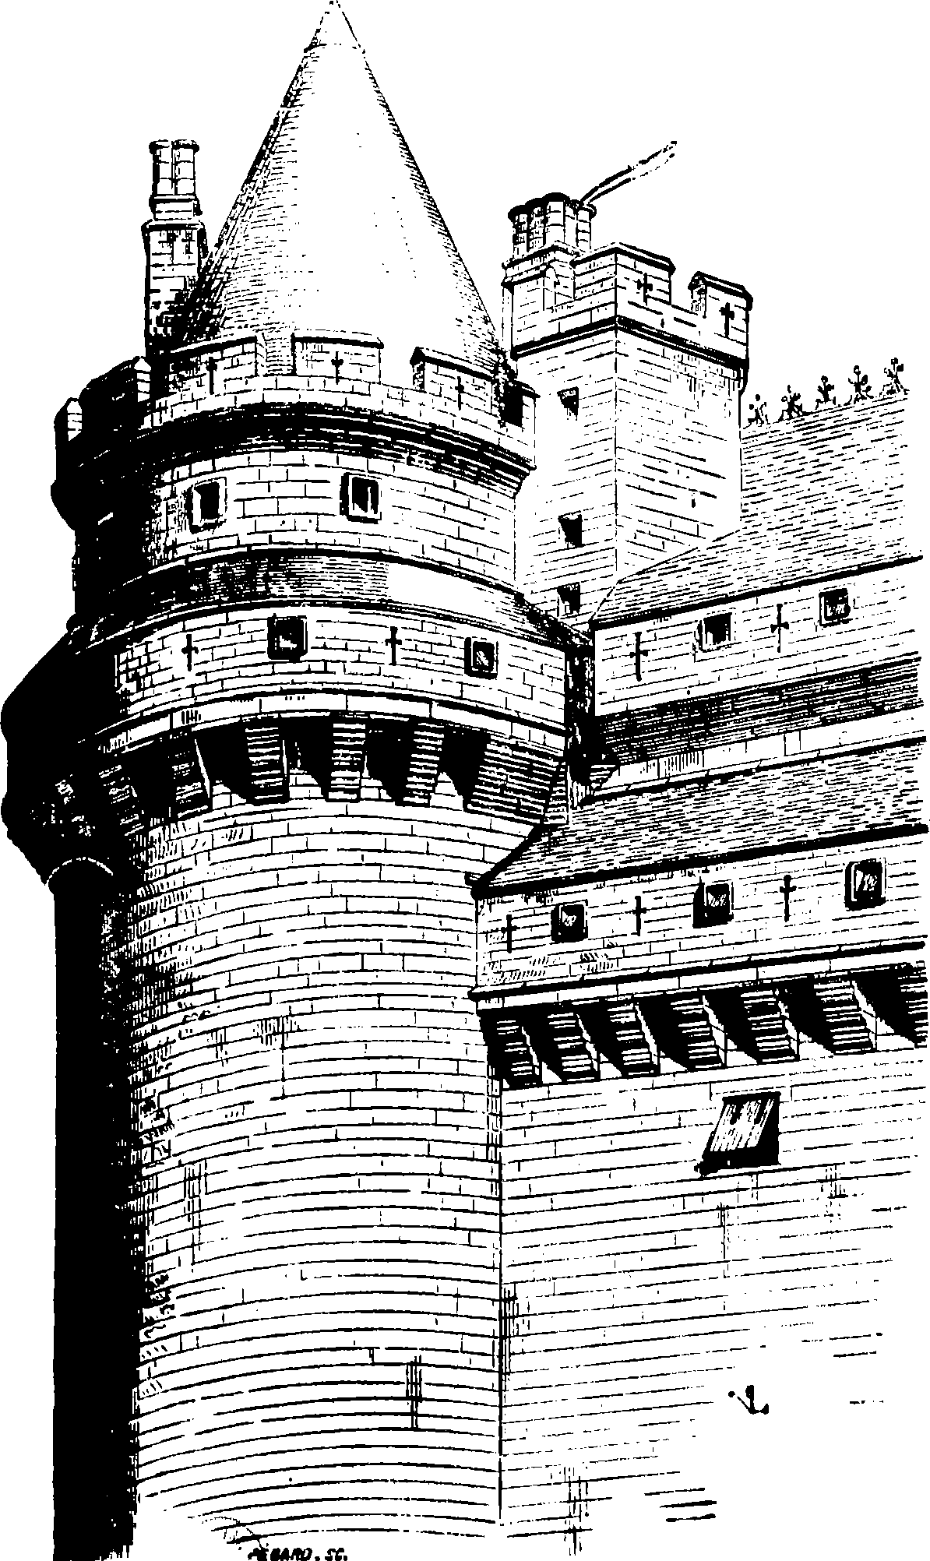




The Risk Equation
Threats
Something or someone that can take advantage of vulnerabilities—such as an attacker, malware, inexperienced user, accident, or disaster
Vulnerabilities
Deficiencies that enable an attacker to violate the system's integrity
Consequences
Damage resulting from a threat taking advantage of the vulnerability
Risk = Threats x Vulnerabilities x Consequences

Slide 26

Threat Modeling
1
Define general security objectives and scope
Collect existing project documentation and guidelines.
Gather security requirements already defined for you, such as compliance and project requirements.
2
Break up your software into conceptual entry points, components, and boundaries where an attacker might interact with your application.
Identify assets an attacker might be interested in, who should be allowed to access each area, and how access is controlled.
Diagram how data flows through the application.
Decompose the software
3
Identify and rank threats
Think like an attacker.
Examine the application and identify where threats exist.
Use tools like STRIDE and DREAD to help you identify and rank threats.
4
Counter each threat
Follow security design patterns to deal with specific types of threats.
Provide countermeasures for each threat you need to address.

Slide 27
Benefits of Threat Modeling
Can save time and problems in the development process.
Enables you to identify design flaws during design, before you start writing code.
Reduces the time and cost needed to fix security issues later on.
May save time in testing since it will show where security tests are needed.
Much more specific than a general project risk analysis.
Will help you perform two types of cost/benefit analysis:
Difficulty vs payoff for an attacker
Value of a countermeasure against the probability of an attack
Consider how attractive a target is.
Provides a high level of detail and insight into potential vulnerabilities in first draft of architecture.
Enables design improvements before any code is written, eliminating the time and expense of rework later.
Should be performed even by solo developers or small teams who don't generally perform a formal risk analysis process.

Slide 28
Step 1: Define General Security Objectives and Scope
Before you even begin threat modeling, some security requirements may already have been defined.
Compliance requirements that dictate certain parameters of the final design.
Non-functional or functional requirements spelled out by project stakeholders.
Business requirements, software requirements, company standards, API documentation, and so forth, which you'll want to have on hand as you perform threat modeling.
Start by pulling together:
Information sources for security requirements, such as:
Project risk analysis
Business requirements
Functional requirements
Non-functional requirements
Any general security, compliance, and other relevant security requirements.

Slide 29

Tooling and Documentation (Slide 1 of 2)
Threat modeling applications:
Can help to automate the task of documenting and creating a report.
May include diagramming features.
May be free.
Word processing and spreadsheet documents are sufficient for the task of documenting a threat model.
Threat modeling templates are available for applications like Word, or you can create your own.
Example tools:
MyAppSecurity ThreatModeler (Commercial application) http://threatmodeler.com/
Microsoft Threat Modeling Tool 2016 (Free application) https://www.microsoft.com/en-us/download/details.aspx?id=49168
SeaSponge (Free web application) http://mozilla.github.io/seasponge/#/
Trike (Free spreadsheet template) http://octotrike.org/

Slide 30
Tooling and Documentation (Slide 2 of 2)
You should include:
Summary information, to distinguish this project from other projects, and for later reference.
Information about the project that will be helpful in identifying possible vulnerabilities:
Title page
The application name
The application version
The name of the document author
Names of other team members who participated in the threat modeling activities
Application's purpose and intended audience
List and description of the application's various user roles

Slide 31
Assets
Things an attacker might target in or through the software you're going to develop.
Should be identified when you identify your security objectives and problem scope.
Includes:
Physical assets: documents, information, client lists, etc.
Abstract assets: the organization's reputation, financial well-being, etc.
Consider how a change in scenario changes the risk.
When you list assets an attacker might target, include information such as the following:
Name–Brief but meaningful name helps readers (including you) to easily refer to the asset.
Unique ID–Helps to clearly identify the asset in an abbreviated fashion.
Description–Text to clarify what the asset comprises, and what needs to be protected.
Trust Level–Identify what access levels should have access to the asset.

Slide 32
Step 2: Decompose the Software
To uncover all vulnerabilities:
Conceptually break up software:
Into various entry points, components, and boundaries where an attacker might interact with your application.
Use a diagram to show how data flows through various parts of the application.
Identify:
Assets an attacker might be interested in
Who should be allowed to access each area
How access is controlled
Consider your use cases to ensure you've documented all of the major components.
By following a detailed and comprehensive process, you can ensure that you've done the best job you can to identify vulnerabilities.
All team members with a detailed knowledge of the software design, including programmers, architects, and system operators, should be involved in this step.
Items that you should identify and document in this step include:
Trust levels
Entry and exit points
External dependencies
Through this process step, you might also uncover additional assets and user roles that you need to include in the lists you developed earlier.

Slide 33

Trust Levels
Identify users and processes operating in various roles.
Examples:
Anonymous User—Anonymous web user who has not yet logged in.
Logged In User—Registered user who has logged in to the website.
Content Administrator—Registered user who has logged in to the website and has administrator access to the database server.
Web Server User Process—Process that the web server uses to execute code and authenticate on the database server.
Through the threat modeling process, you will identify how trust levels are associated with other elements in the threat model, such as which assets they provide access to.
When you list trust levels, include information such as the following:
Name—A brief but meaningful name that describes a user and/or process operating in the role associated with this trust level.
Unique ID—Gives a short, convenient way to refer to the trust level elsewhere in your documentation.
Description—Describe the external entity who will be assigned the trust level, and (if applicable) the role or task the entity would perform with this trust level.

Slide 34
Entry and Exit Points
User interfaces and application interfaces through which:
Users and external systems interact with the software, send inputs, or receive outputs.
Software may be attacked.
It is important to carefully identify every entry point you can think of.
May be things such as the routine where the front-end web application listens for HTTP requests, APIs, interfaces between subsystems, and so forth.
A single component, such as a web page, might have multiple input and exit points.
When you list entry and exit points, include information such as the following:
Name–A brief but meaningful name helps readers (including you) to easily refer to the entry or exit point.
Unique ID–Helps to clearly identify the entry or exit point in an abbreviated fashion elsewhere in the documentation.
Description–Provide text as necessary to clarify the function call or interaction that occurs at the entry point.
Trust Level–The levels of access required at the entry or exit point are listed here.

Slide 35
External Dependencies
List of components and systems the application depends on:
Includes operating systems, frameworks, libraries, APIs, services, third-party user interface components, and so forth.
Any code you didn't create.
Items that may contain vulnerabilities.
Identify the expected configuration, including network configuration (required firewall rules, etc.) of portions of the system deployed to:
A local server
Cloud service
A particular device
Some other production environment
When you list external dependences, include information such as the following:
Name–A brief but meaningful name helps readers to easily refer to the dependency.
Unique ID–Helps to clearly identify the dependency in an abbreviated fashion elsewhere in the documentation.
Description–Provide text as necessary to clarify what the external dependency is, and what it's used for.
Version Number–If the external dependency has a particular version number, make note of it. This will make it easier to look up vulnerabilities later.

Slide 36
Data Flow Diagram Example
Web pages in File Storage
File Data
End User
Requests
File Read Requests
Responses
Web
Server
End User Privileges
Requests
Site Content Administrator
Responses
Content Admin Privileges
Web Server Privileges

Slide 37
Diagramming Symbols
External Entity
Data Flow
Process
Multiple Processes
Trust Boundary
Data Store

Slide 38
Activity: Diagramming the Catalog Application
Web page templates, images style sheets
Product Data in Database
File Data
End User
Requests
File Read Requests
Product
Data
Data Requests
Responses
Application
Server
(Node.js)
Database
Queries
Database Server
Requests
Product
Data
Site Content Administrator
Responses
Present product catalog and take orders

Slide 39
Catalog Application Trust Boundaries
Web page templates, images style sheets
Product Data in Database
File Data
End User
Requests
File Read Requests
Product
Data
Data Requests
Responses
Application
Server
(Node.js)
End User Privileges
Database
Queries
Database Server
Requests
Product
Data
Site Content Administrator
Responses
Present product catalog and take orders
Content Admin Privileges
Web App Server Privileges
Database Server Privileges

Slide 40
Step 3: Identify and Rank Threats
Data flow diagrams can be very helpful in guiding your areas of focus.
Identify how an attacker might take advantage of a weak design or coding errors in critical areas.
Identify misuse cases to identify where protections are needed and to rank them by impact.
Take multiple, methodical passes through diagrams to ensure results are comprehensive:
Work through general categories of threats, considering how you might launch an attack.
Work through categories such as spoofing, tampering, repudiation, and denial of service.
Brainstorm with others to identify ways each critical component or junction might be attacked.
Lists of threat categories, such as STRIDE and PASTA, can guide you through this task.
Work through critical locations in your data flow diagram, looking for specific vulnerabilities.
Use tools and lists to organize and guide you.
MITRE's CAPEC Dictionary
Lists such as OWASP's top ten
Books such as:
24 Deadly Sins of Software Security by Howard, LeBlanc, and Viega
Security for Web Developers by Mueller
Focus on entry and exit points, and data flows that cross trust boundaries.

Slide 41
STRIDE Classification Scheme
Approach developed by Microsoft for classifying types of exploits or security threats.
The STRIDE acronym provides a way to easily remember the scheme.
The list can be useful when you need to brainstorm or categorize various ways that your app might be exploited:
Spoofing Identity
Tampering with Data
Repudiation
Information Disclosure
Denial of Service (DoS)
Elevation of Privilege

Slide 42
PASTA
Process for Attack Simulation and Threat Analysis
Define business objectives
Define technical scope
Decompose the software
Analyze threats
Detect vulnerabilities
Enumerate attacks
Analyze risks and impact

Slide 43
Misuse Cases
Use cases:
Are normally identified when you define software requirements.
Consist of:
An actor (such as a user, administrator, service provider, and so forth)
An action (such as log in, search, make a payment, and so forth)
Are helpful to:
Precisely determine software behavior that is allowed in a certain context.
Express behavior in terms that provide clarity for developers and testers.
Misuse cases:
Identify negative requirements, software behavior that should not be allowed.
Are helpful to:
Define security requirements.
Identify actions that should be prevented.
May also be called “abuse cases” or “attack scenarios.”
Different actors will have different needs and actions:
End users will need to log on.
Admins might search for accounts, configuration details, and error messages.
Financial institutions will collect and receive payments.
Service providers will be concerned with product or service delivery.

Slide 44
Security Zones
A portion of the system in which the threats to your software are similar.
For example:
A mobile app communicating over the Internet or public Wi-Fi connection is exposed to different threats than when it communicates through a USB cable to a desktop computer.
Threats on a private network are different from those on a public network.
The capabilities and access your software requires:
May differ in various security zones.
May differ depending on the user or use-case context.
As you consider each security zone, evaluate threats by considering:
Who has access to the zone?
What would motivate someone to attack in this zone?
What specific targets (data, functions) are available in this zone?
How might each target be attacked? (Refer to STRIDE.)
What is the business impact of an attack here? (Loss = impact x probability)
What remediations might reduce the possibility of attack?
Would you recommend prevention based on the likelihood, magnitude, and repercussions of such an attack?
Based on the ideas you generate from this analysis, perform a risk analysis to determine which risks you need to address and how you would address them.

Slide 45
Strategies for Ranking Threats
Assign a value to the extent of damage afforded by each threat.
Prioritizes threats (e.g., high, medium, low).
Helps to inform how you handle them, such as:
Deciding which threats to spend the most time on.
Deciding which threats to handle first.
Typical factors include such things as:
Ease of exploit—How easily the vulnerability can be discovered and exploited.
Likelihood—How likely that an attacker will choose to exploit the vulnerability.
Impact—Potential for damage, number of affected components, number of users who would be affected, and so forth.
Different threat modeling strategies provide different tools and processes for calculating such threat values.

Slide 46
DREAD
Development by Microsoft
Builds upon the traditional risk model Risk = Likelihood x Impact
Example:
Suppose you evaluated a particular threat and assigned a 10-point value to each of the following questions as shown.
Ease of Exploitation:
Discoverability–How easily can an attacker discover this threat? 8, relatively easy
Reproducibility–How easy is it to reproduce an attack to work? 10, very easy
Exploitability–How much time, effort, and expertise is needed to exploit the threat? 7, relatively easy
Impact:
Affected Users–What percentage of users would be affected? 10, affects all users
Damage–How great would the damage be in a successful attack? 9, very high
Overall score would be (8+10+7+10+9)/5, or 8.8 out of 10, which is fairly high risk threat.

Slide 47
Risk Response Strategies
Testing Method | Description
Risk avoidance | Eliminate the risk (reduce it to zero). You might accomplish this by averting the process, activity, or application that causes the risk. For example, if a particular optional software feature brings unacceptable risk into play, you might simply decide to not include that feature to eliminate the risk it brings.
Risk transference | Move the responsibility for the risk partially or completely to another organization, such as an insurance company or an outsourcing provider. For example, you might outsource a particular web service from a vendor who will pay penalties if the service fails. Risk transference might be appropriate if the risks are larger and more complicated than your enterprise can manage on its own.
Risk mitigation | Implement controls and countermeasures to reduce the likelihood and impact of risk to the organization. For example, you might write code that prevents users from entering certain data values that might present a security problem.
Risk acceptance | Agree that the risk is acceptable without taking any additional action. Perhaps the consequences are negligible or easily recovered from. Not all risks can be avoided; likewise, not all risks can be transferred or mitigated. As you develop software, you must decide what level of risk is unlikely or does not have enough potential for harm to warrant extra effort and cost.

Slide 48
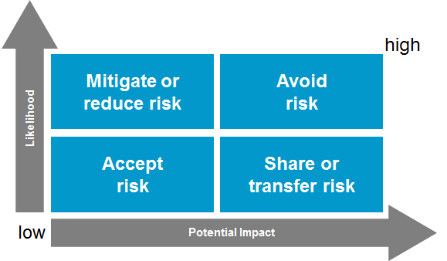
Plotting Severity
To estimate the potential impact, follow an approach such as the following:
Type of attack: SQL injection
Likelihood that such an attack could be carried out: High
Value of exposed data: $100 per data record
Number of exposed records: 10,000
Aggregate potential loss: $100 × 10,000 = $1,000,000
Probability of such an attack: 10% (i.e., once in a 10 year period)
Potential economic impact: $1,000,000 × 10% = $100,000

Slide 49
The Responsibility for Risk Management
An effective defense:
Requires more than individual countermeasures.
Requires you to manage security of the whole system—including the application, the host environment (e.g., a web application server), users, physical security of the users' computers.
Example:
You provide authentication and access control features in the software.
User walks away while logged in to computer.
Attacker would have access to the system despite the security features you provided.
Software can:
Defend against many types of risks.
Monitor some user behavior.
Detect some host system and network configuration problems.
Provide appropriate security controls.
Software cannot:
Completely control user behavior or the configuration of systems it runs on.
The extent of the software developer’s influence depends on the situation.
You may have some influence outside of the software if:
You are developing custom applications for a business.
You have some direct contact with your user base.
You have some influence over security policies enforced within the business.
You may have little or no influence outside of the software if:
You are releasing apps in a mobile app store.
Your software isn't installed or directly used by customers (embedded software, for example).

Slide 50
Manage Risks Outside Your Direct Control
Even without complete control over user behavior, you might be able to:
Provide documentation (Help system, for example) and messaging (prompts and warnings) within the software to advise users on security practices.
Provide security configuration checks within installation scripts and documentation.
If you're developing custom software for an organization, work with other groups in the organization to provide end-user training, influence company security policies, ensure appropriate firewall and malware protection is in place, and so forth.

Slide 51
Step 4: Counter Each Threat
In this step, you'll identify how you will:
Avoid certain threats entirely, or
Apply countermeasures for those threats you cannot avoid
There are lists of countermeasures for common threats.
MITRE's CAPEC includes strategies for solving and mitigating the different types of attacks described in the list.
OWASP Top 10 and other resources on the OWASP website provide good countermeasure strategies and example code.
Community sites for operating systems, development platforms, and tools, also provide examples of countermeasures in various programming languages.

Slide 52
Countermeasures
Exploit Type | Countermeasures
Spoofing Identity | Use strong authentication Protect sensitive information | Don't store sensitive information in cleartext Protect authentication cookies with encryption (by using SSL, for example)
Tampering with Data | Use strong authorization Use data hashing Use digital signatures | Use message integrity codes (MICs—also called message authentication codes, or MACs) Use tamper resistant protocols across communication links
Repudiation | Use digital signatures Use timestamps | Create secure audit trails
Information Disclosure | Use strong authorization Use privacy-enhanced communication protocols Use strong encryption | Protect sensitive information Don't store sensitive information Don't store sensitive information in cleartext
Denial of Service (DoS) | Appropriate authentication Appropriate authorization | Validate and filter inputs Use resource and bandwidth throttling to limit usage
Elevation of Privilege | Run with least privilege

Slide 53
Activity: Identifying Threats and Countermeasures
Web page templates, images style sheets
Product Data in Database
File Data
End User
Requests
File Read Requests
Product
Data
Data Requests
Responses
Application
Server
(Node.js)
End User Privileges
Database
Queries
Database Server
Requests
Product
Data
Site Content Administrator
Responses
Present product catalog and take orders
Content Admin Privileges
Web App Server Privileges
Database Server Privileges

Slide 54
Threat Examples
Brute force password attack
SQL injection in login form
Unauthorized access of another customer’s account
Web page templates, images style sheets
Product Data in Database
File Data
End User
Requests
File Read Requests
Product
Data
Data Requests
Responses
Application
Server
(Node.js)
End User Privileges
Database
Queries
Database Server
Requests
Product
Data
Site Content Administrator
Responses
Present product catalog and take orders
Content Admin Privileges
Web App Server Privileges
Database Server Privileges
Unauthorized access of admin account
Purchase products through another user’s account
View or modify files not intended for public access: log files, web page content, application code, etc.
Apply unauthorized coupons, discounts
Post product feedback in another user’s name
Inject SQL, JavaScript, or HTML in Search form
Unauthorized viewing or modification of database data

Slide 55
Countermeasure Examples
Brute force password attack
SQL injection in login form
Unauthorized access of another customer’s account
Require strong passwords
Input validation and strip out SQL
Strong authentication controls
Web page templates, images style sheets
Product Data in Database
File Data
End User
Requests
File Read Requests
Product
Data
Data Requests
Responses
Application
Server
(Node.js)
End User Privileges
Database
Queries
Database Server
Requests
Product
Data
Site Content Administrator
Strong authentication and access control
Access control on file system
Timed deletion of coupon codes and discounts
Input validation on all UI controls and APIs
Responses
Present product catalog and take orders
Content Admin Privileges
Web App Server Privileges
Database Server Privileges
Unauthorized access of admin account
Purchase products through another user’s account
View or modify files not intended for public access: log files, web page content, application code, etc.
Apply unauthorized coupons, discounts
Post product feedback in another user’s name
Inject SQL, JavaScript, or HTML in Search form
Unauthorized viewing or modification of database data
Require strong passwords
Strong authentication controls
Access control on file system
Access control on database
IP security
Database encryption

Slide 56
For you and the type of projects you work on, which of the Top 10 Software Security Design Flaws represents the greatest challenge for software development?
What steps will you take to ensure you and your development team adhere to principles for security design such as those presented in this lesson?

